Slide 1
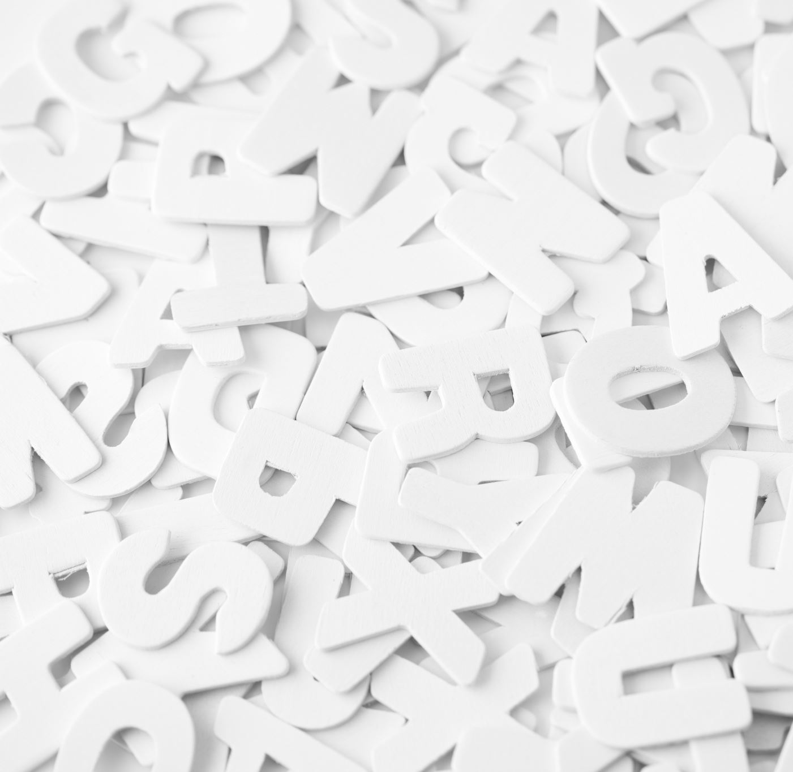
JavaScript
15.02.2024

Slide 2
For loop

